Slide 1
Creating Games
Brainstorming Session

Slide 2
The Plan
We will use computer parts to create our characters in the computer games
We will work to design two kinds of games
PacMan Type Games
“Level” Games (such as Super Mario Games)

Slide 3
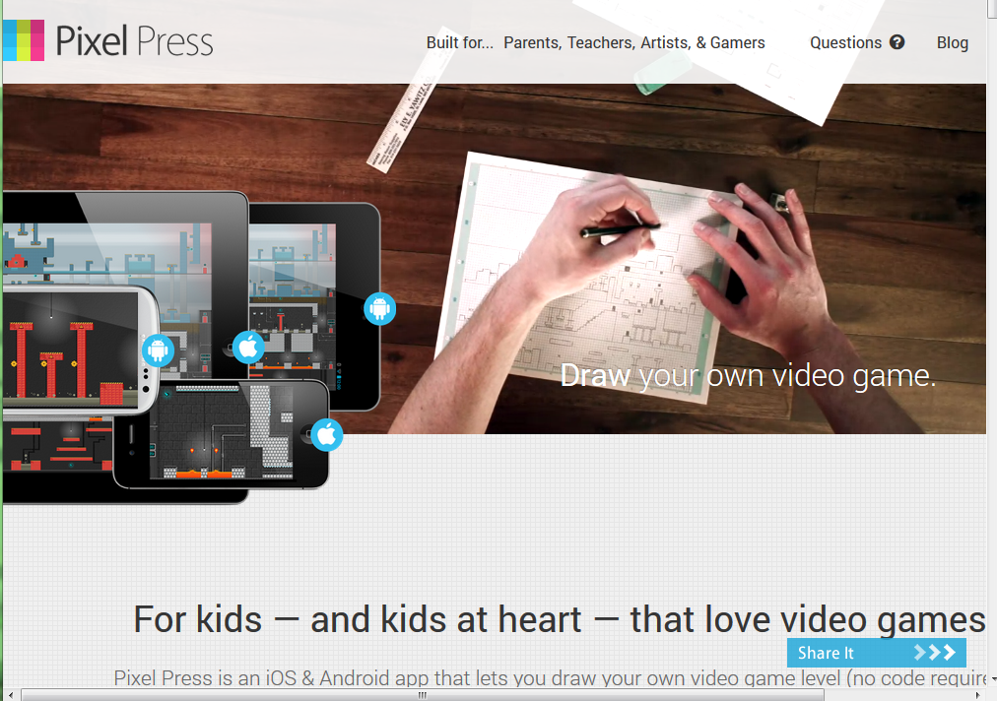
Pixel Press Software

Slide 4
PacMan Games
Classic game in a maze
Goal:
eat up “food” (also known as pills)
search for goal
avoid being destroyed by ghosts

Slide 5
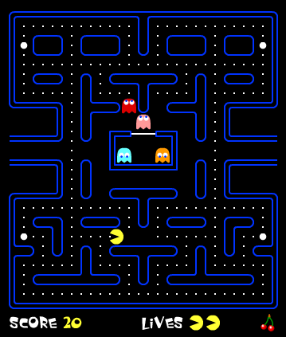

Slide 6
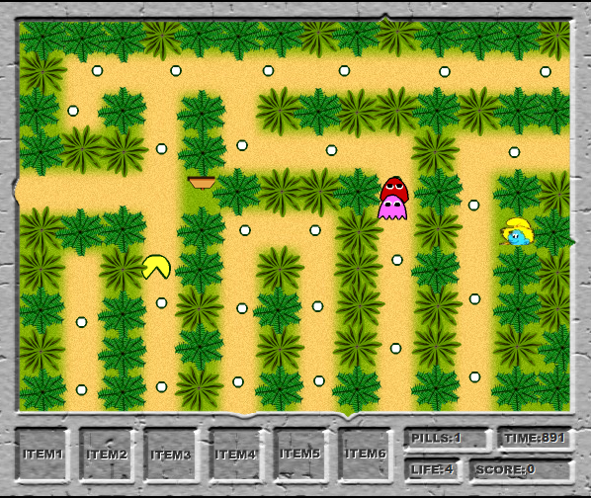

Slide 7
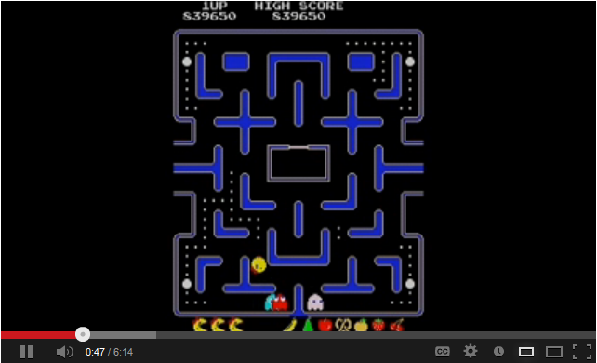
A Video

Slide 8
Level Games
Games with a linear progression of difficulty
Each level has a goal
When goal is achieved, they move to the next level
Laid out in 2-D or 3-D
Generally have varying elevation and physical obstacles, and movement
Character-based

Slide 9
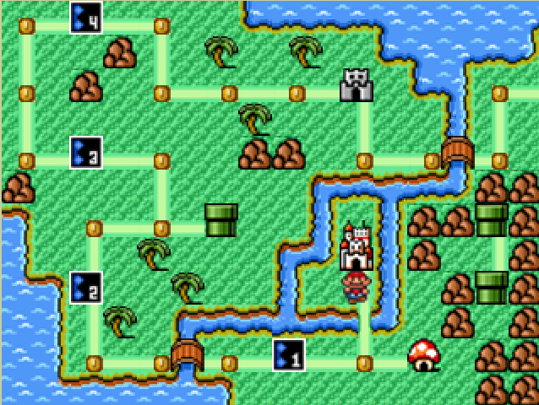
Classic Example: Super Mario Brothers

Slide 10
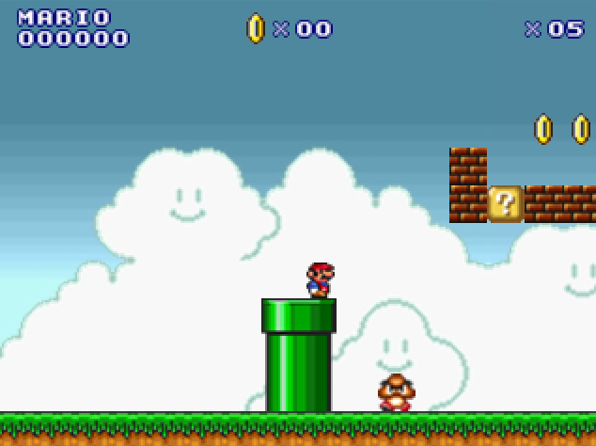
Varying Elevation

Slide 11
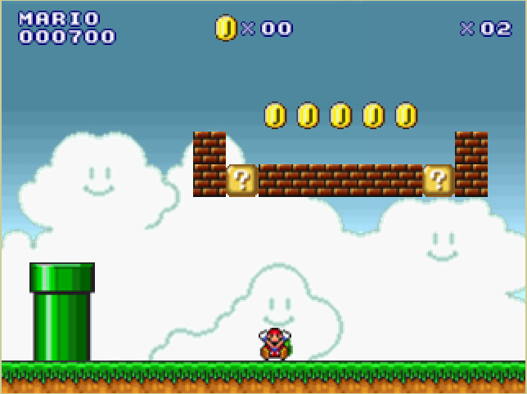
Character Traps

Slide 12
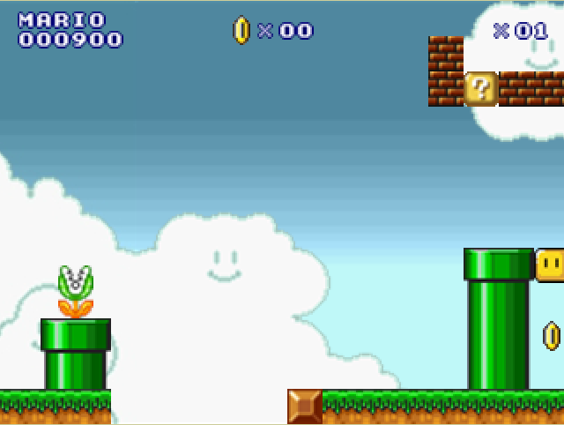
Barriers and Gaps

Slide 13
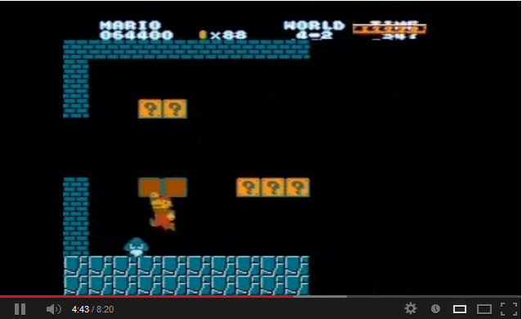
A Video

Slide 14
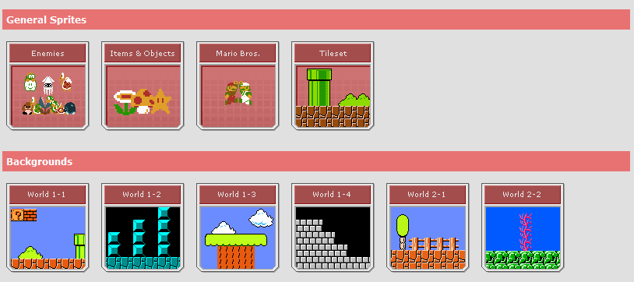
How Do We Create them?

Slide 15
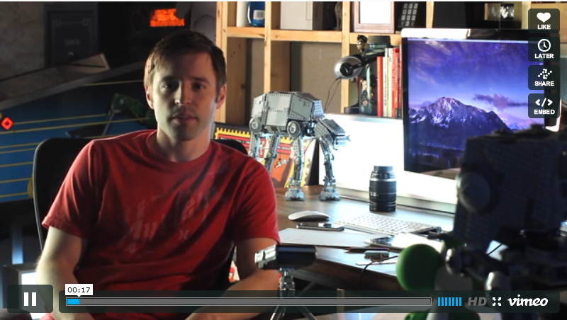
More about Pixel Press

Slide 16
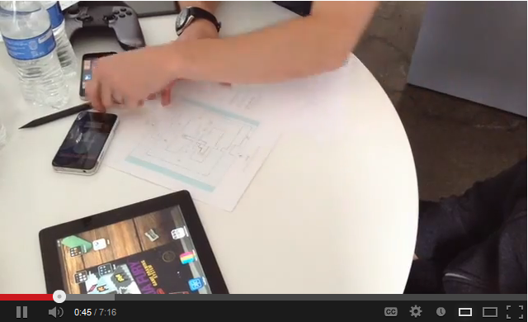
Designing PacMan Games

Slide 17
Time for Brainstorming!
Think about a PacMan type game
How will the maze appear?
What will be your hazards?
What might your characters be?
Background? Colors?

